Slide 1




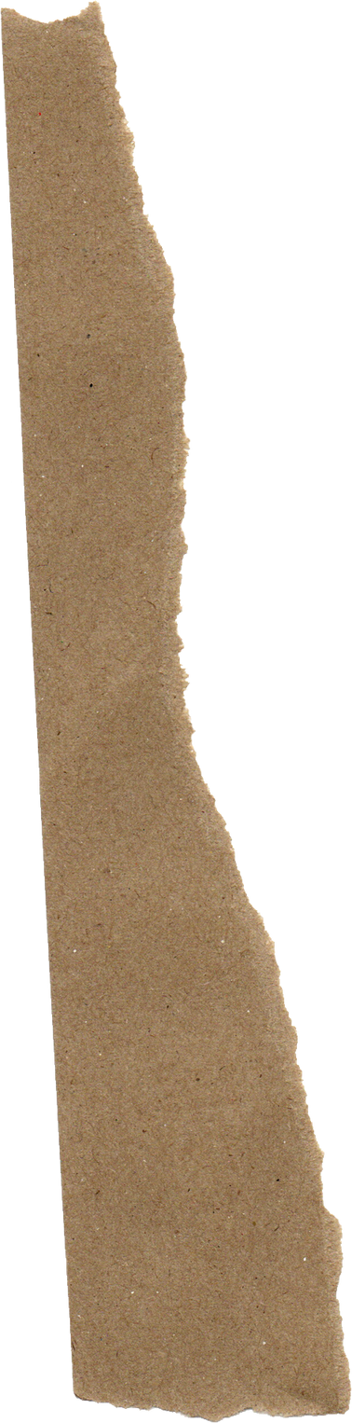




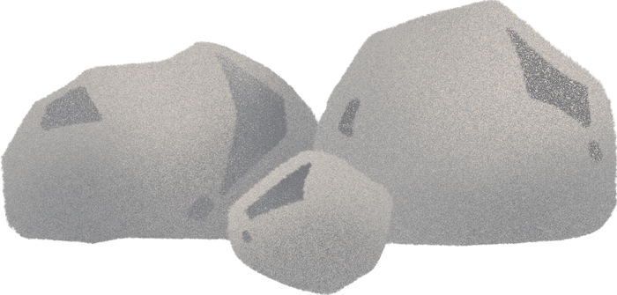
Voices in the Stones
The rocks are crying, they’re screaming out: “What is my name?!?”

Slide 2




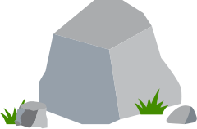
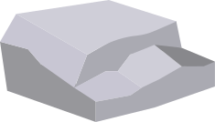
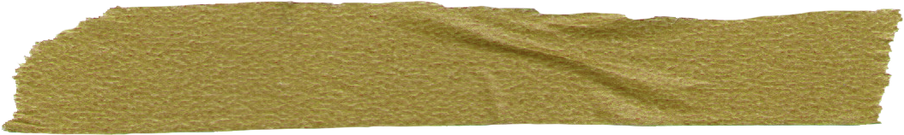
Instructions
You are the field geology team. Use the following slides and their clues to identify unknown rock/mineral samples and document on your table.
Tip :
It’s okay to to be wrong, but it’s never okay to not try

Slide 3






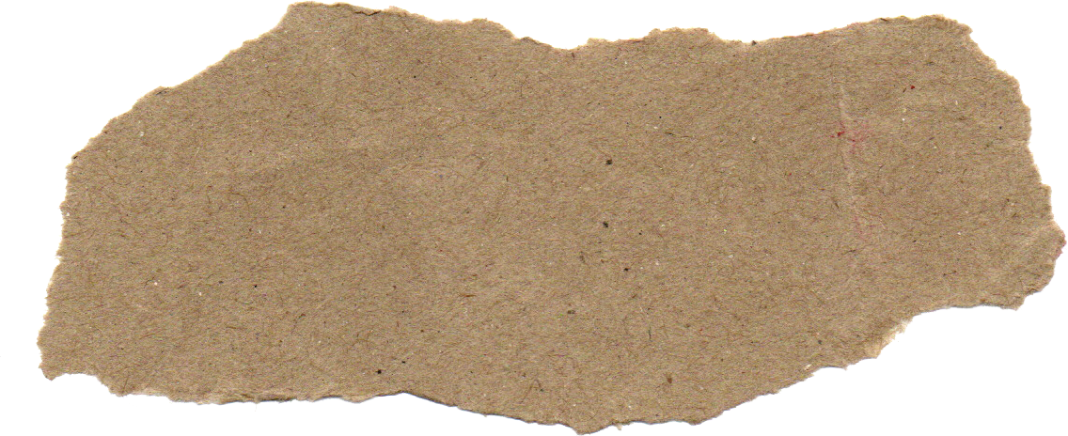

ROCK BANK
GRANITE
SANDSTONE
PUMICE
SLATE
QUARTZ
BASALT
MARBLE
OBSIDIAN
SHALE
HALITE
LIMESTONE
GNEISS
“Geologists have a saying – rocks remember.”
-Neil Armstrong

Slide 4
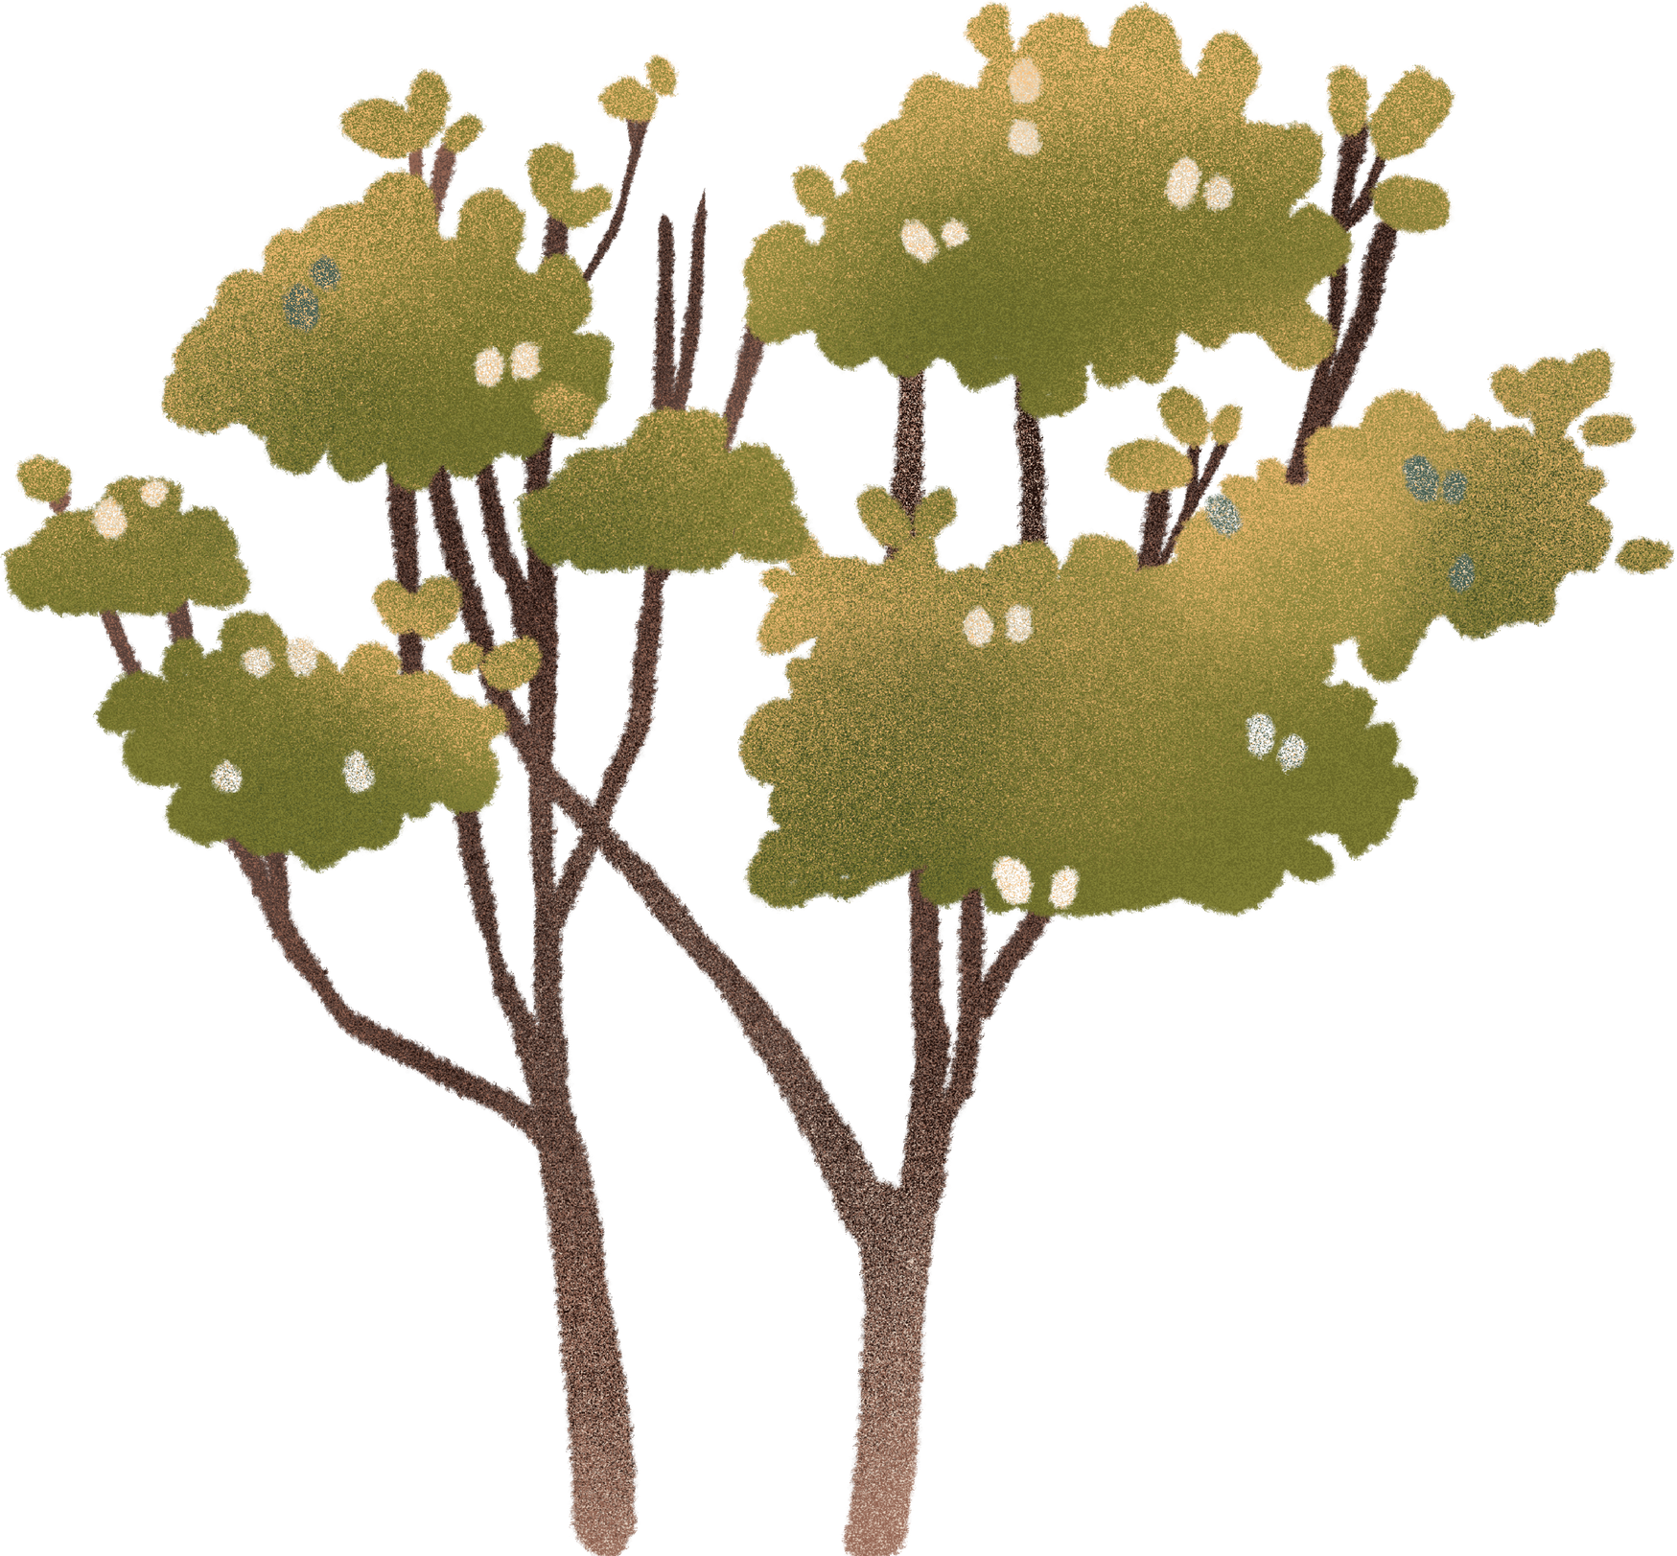
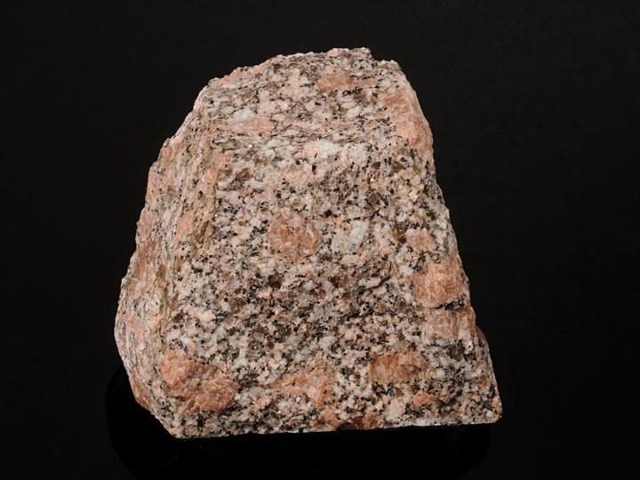
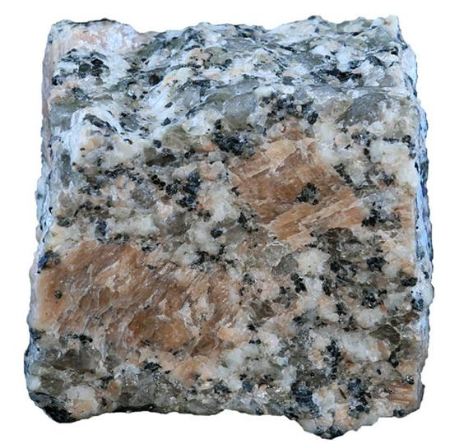


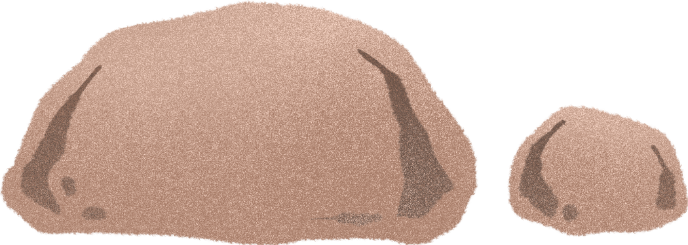
“Geology is the music of the Earth”
-Hans Cloos
STATION 1
CLUES
1.
This rock has a distinctive coarse grained texture that comes from a long period of cooling before solidifying.
2.
This rock erodes VERY slowly!
3.
Formed deep in the earth’s crust from cooling magma. The slower it cools, the larger the crystals become!
Interesting Facts:
Used for headstones, monuments, countertops.
Four presidents have their face permanently carved into this rock! (Mount Rushmore)

Slide 5

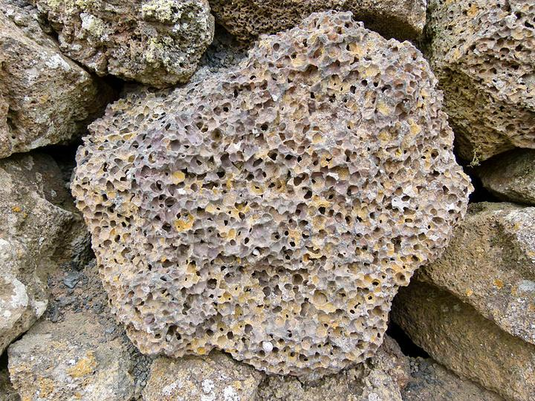
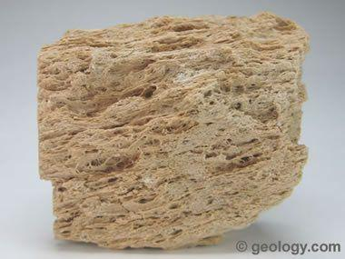
“The most dangerous phrase in the language is -We’ve always done it this way”
-Grace Hopper
STATION 2
CLUES
1.
This rock looks like a sponge and is very light in weight!
2.
This rock can float on water
3.
Formed by volcanic eruptions and rapid cooling. It cools so fast that atoms are not able to arrange into a crystal structure.
4.
Is neither a rock or mineral. It is an amorphous volcanic glass known as a “mineraloid”
Interesting Facts:
Helped enable Pueblo farmers to survive on the slopes of the Jemez Mountains in New Mexico beginning in the 1200's.
Wild chinchillas seek out places rich in loose pumice to take dust baths in order to keep their fur clean and their skin free from parasites.

Slide 6
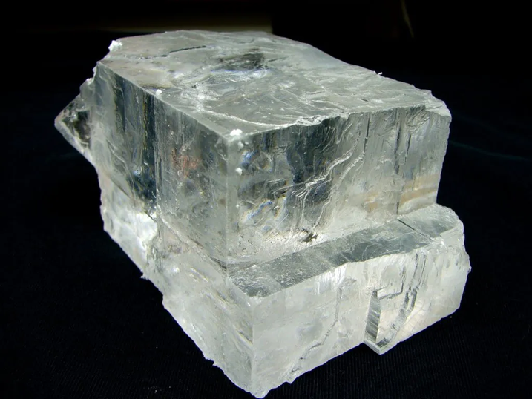
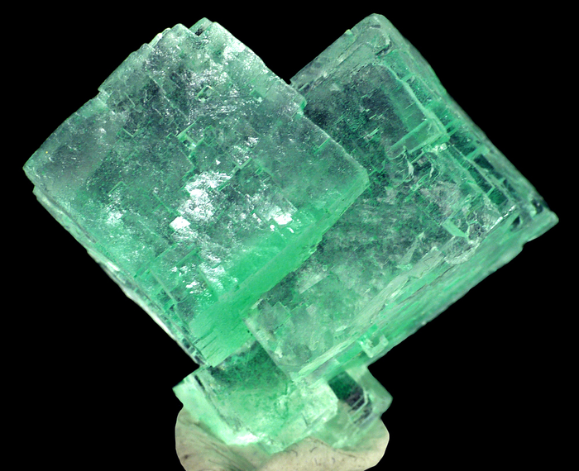
“The whole of science is nothing more than a refinement of everyday thinking”
-Albert Einstein
STATION 3
CLUES
1.
This rock has a very distinct taste if you were to lick a physical sample
2.
This rock is VERY soluble in water (dissolves easily)
3.
Scratches very easily (Your fingernail could scratch this mineral)
4.
Usually transparent, but can take on different colors depending on the chemical composition
Interesting Facts:
Is used to de-ice roads during the winter
Has helped many cultures succeed by allowing food to be preserved longer
Can trap large amounts of oil and gas
Was once as valuable as money

Slide 7
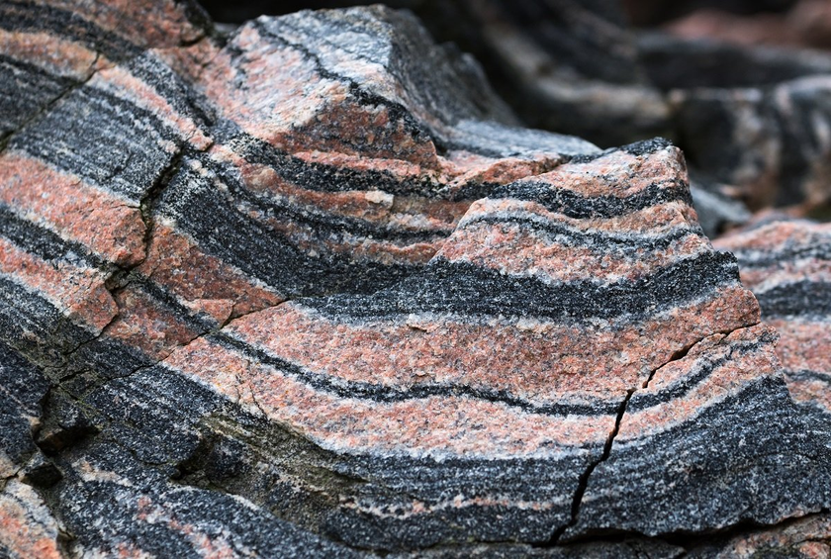
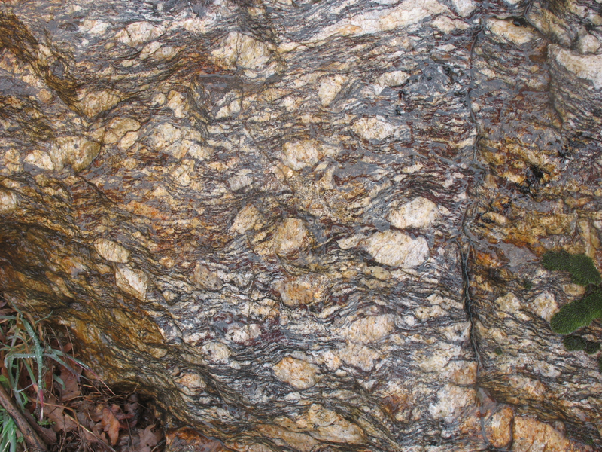
“The saddest aspect of life right now is that knowledge gathers faster than society gains wisdom”
-Isaac Asimov
STATION 4
CLUES
1.
Type of metamorphic rock
2.
Distinc alternating layer pattern
3.
Parent rock is often granite
Interesting Facts:
Used in monuments and historic buildings in Europe
Valued as a landscaping rock
Sometimes used as countertops or flooring

Slide 8
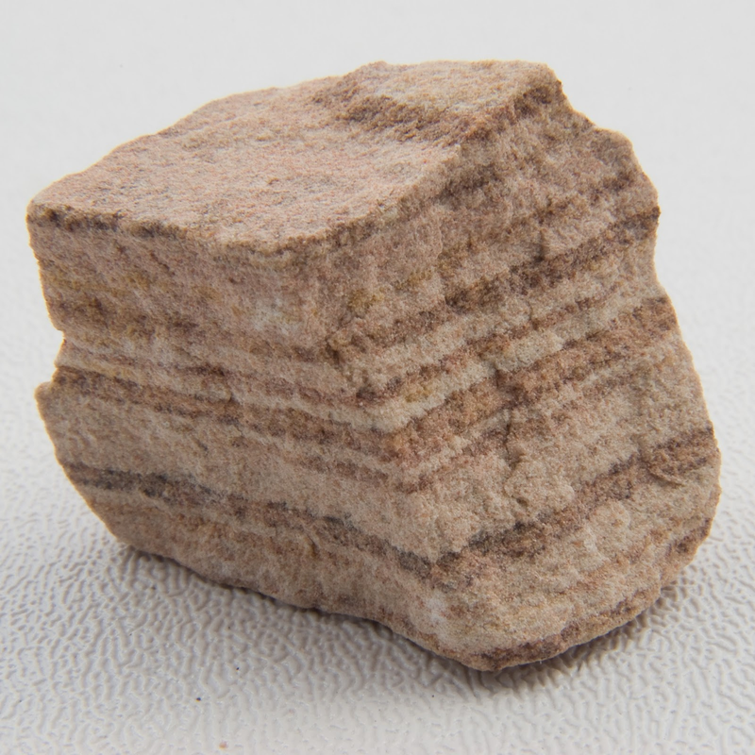
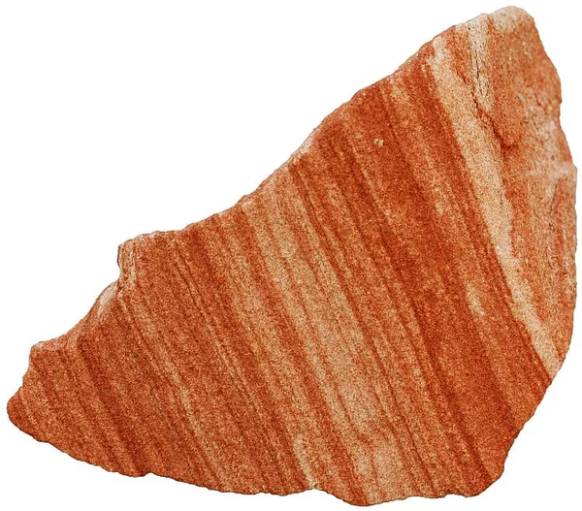
“[one] who dares to waste one hour of time has not discovered the value of life”
-Charles Darwin
STATION 5
CLUES
1.
Sedimentary rock made up of broken pieces of other rocks
2.
Often layered
3.
Feels gritty
4.
Usually a tan, brown or red color. Can often be very stained with iron.
Interesting Facts:
Famous monuments like Petra (Jordan) have been carved into this material
Can act like an aquifer, storing drinking water and supporting communities
Widely used in indigenous tools (grinding stones)

Slide 9
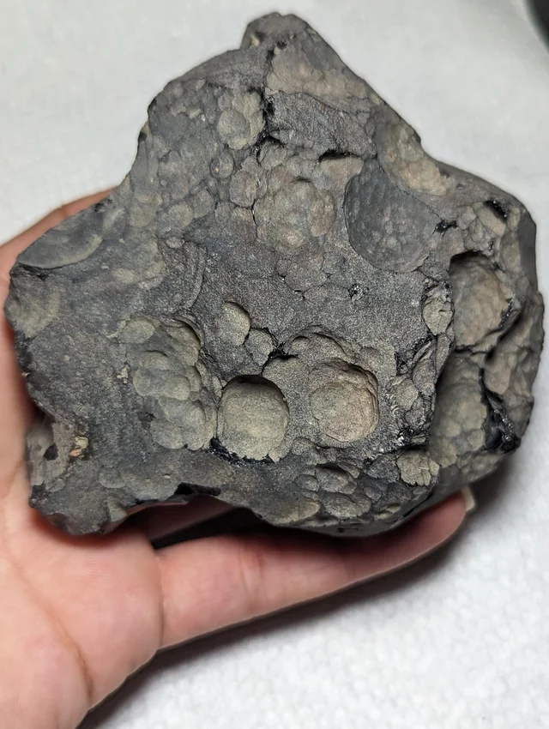
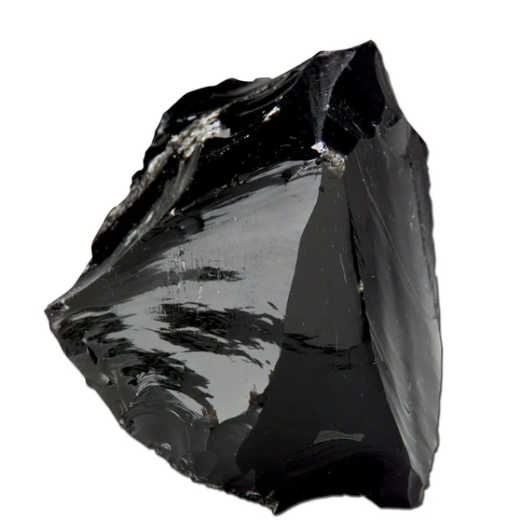
“The good thing about science is that it’s true whether or not you believe in it.”
-Neil deGrasse Tyson
STATION 6
CLUES
1.
Volcanic Glass! CAUTION! This can be VERY sharp!
2.
Usually black, but can be brown or green
3.
Smooth, glassy texture
Interesting Facts:
Has been used by indigenous people for arrowheads and knives
Has been used as surgical scalpels
Can be sharper than steel

Slide 10
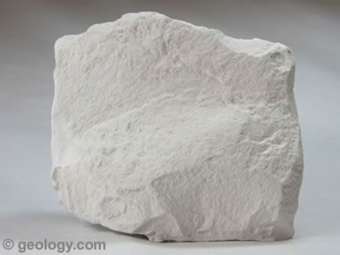
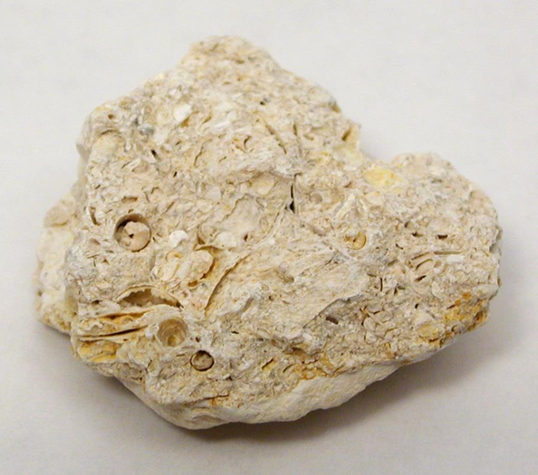
“Nothing in life is to be feared, it is only to be understood. Now is the time to understand more, so that we may fear less”
-Marie Curie
STATION 7
CLUES
1.
Sedimentary rock, often lighter in color
2.
Often contains lots of fossils due to being deposited in marine environments
3.
Typically softer and can be scratched by your nail, but not necessarily.
4.
Reacts with acid (fizzes)
Interesting Facts:
Classrooms all over the world have traditionally used this material
Used to build the Pyramids of Giza
Used in Agriculture to control soil acidity
Still used in modern architecture

Slide 11
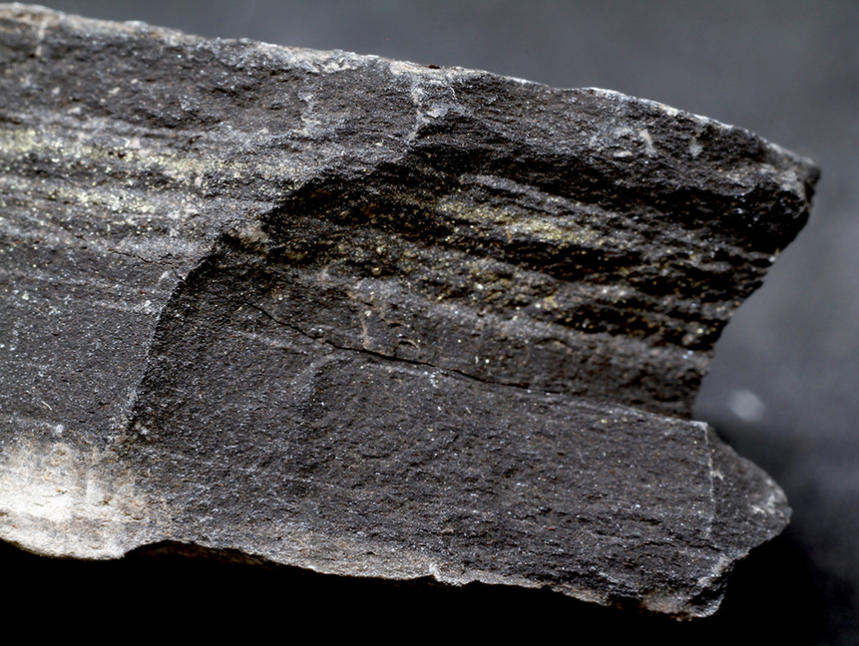
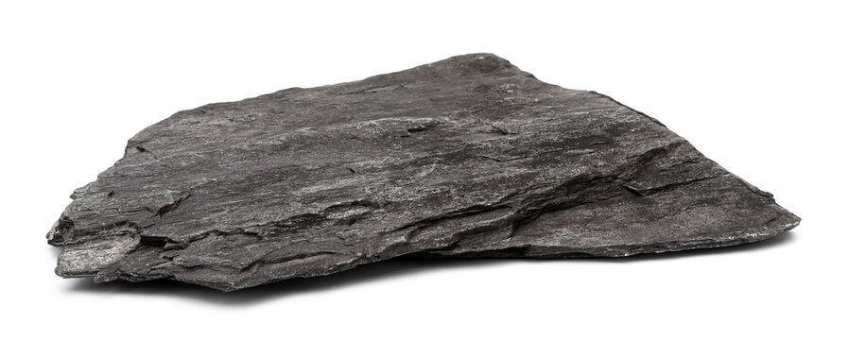
“You cannot teach [a person] anything; you can only help him discover it in himself”
-Galileo Galilei
STATION 8
Interesting Facts:
Source rock for oil and natural gas
Used in the manufacturing of cement
Can contain fossils of delicate plants and animals
Helped to revolutionize U.S. energy production
CLUES
1.
Sedimentary rock with VERY thin layers
2.
Often darker in color such as gray, black or brown
3.
Easily splits into sheets

Slide 12
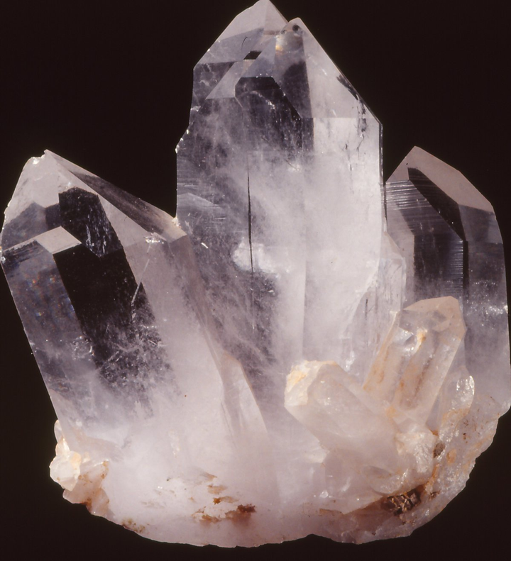
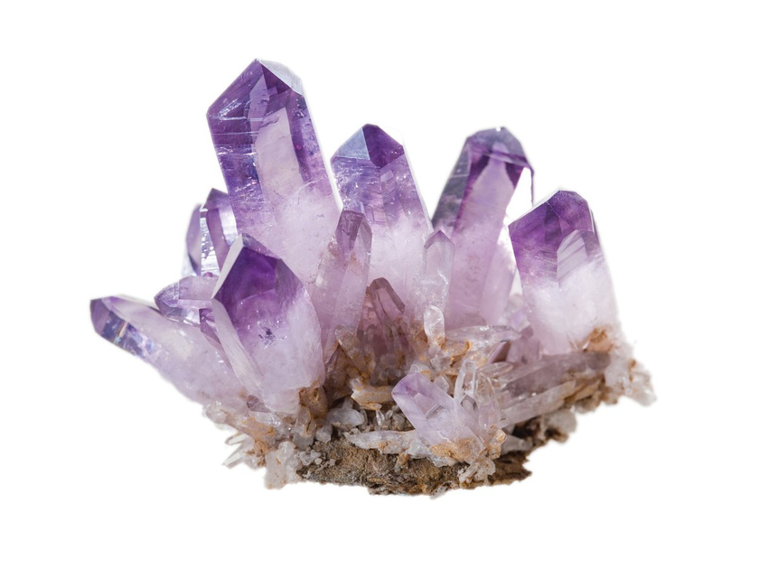
“If I have seen further it is by standing on the shoulders of Giants.”
-Isaac Newton
STATION 9
CLUES
1.
Typically scratches glass. Hardness around 7
2.
Usually colorless, but can take on many different colors such as pink, purple, rose, etc.
3.
Extremely common rock
4.
Makes up a lot of beach sands when this is broken up
Interesting Facts:
Crystals have been used in spiritual/healing practices
Used in watches to keep time
Was once as valuable as a ruby or emerald
Used in electronics, abrasives (sandpaper) and glassmaking

Slide 13
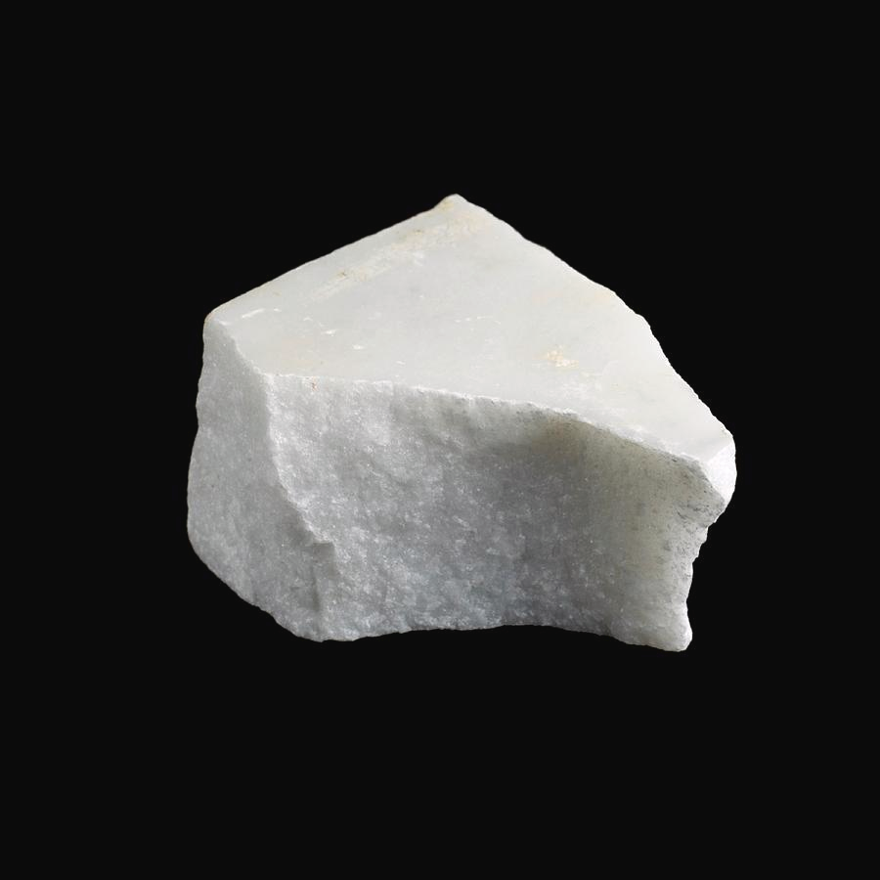
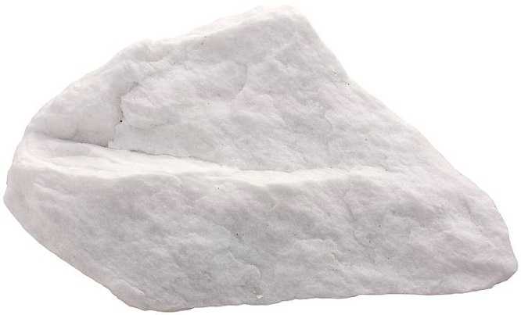
“Equipped with his five senses, man explores the universe around him and calls the adventure Science.”
-Edwin P. Hubble
STATION 10
CLUES
1.
Metamorphic rock
2.
Reacts with acid
3.
Can be white, gray, green, pink or show veining. Fairly soft
Interesting Facts:
Used for headstones, monuments, countertops.
Michelangelo’s David was carved from this material
Symbol of luxury in architecture/decor

Slide 14
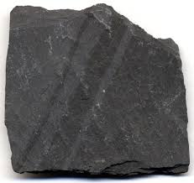
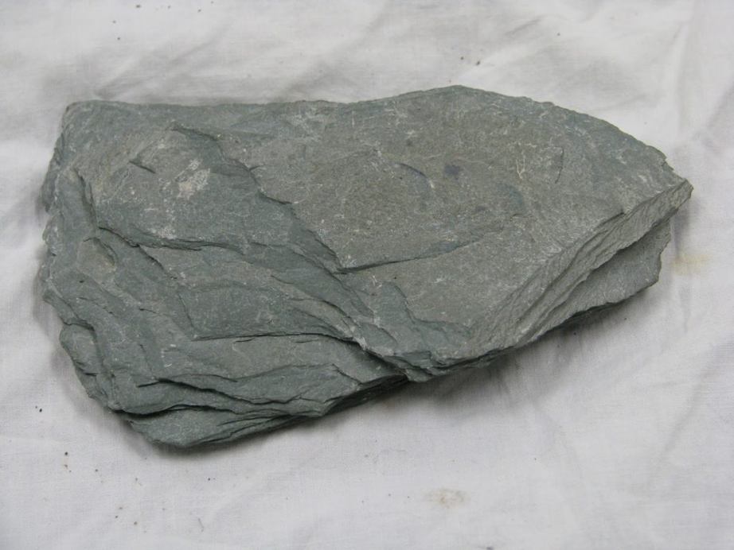
“My Mission [is] to protect what is human in a world of machines.”
-Dr. Joy Buolamwini
STATION 11
CLUES
1.
Metamorphosed rock
2.
Splits into sheets very easily
3.
Interesting Facts:
Has been used as roofing material
Used to be used to make blackboards (chalkboard)
Traditional gravestone and memorial marker
Has a distinctive “ping” when struck like a bell
Typically gray, black, or purpleish and hard to distinguish grains
4.
Very durable and resistant to weathering

Slide 15
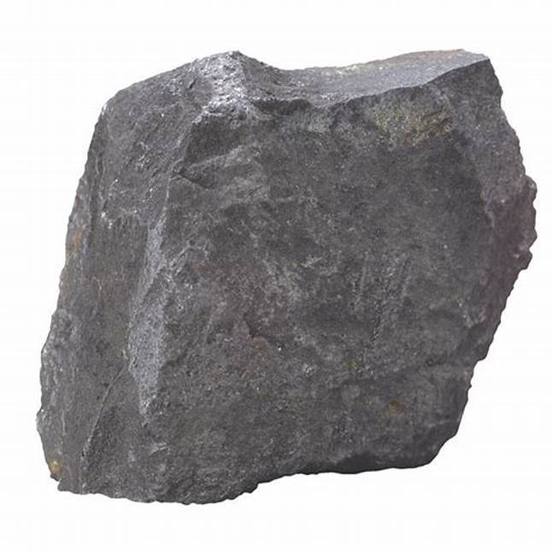
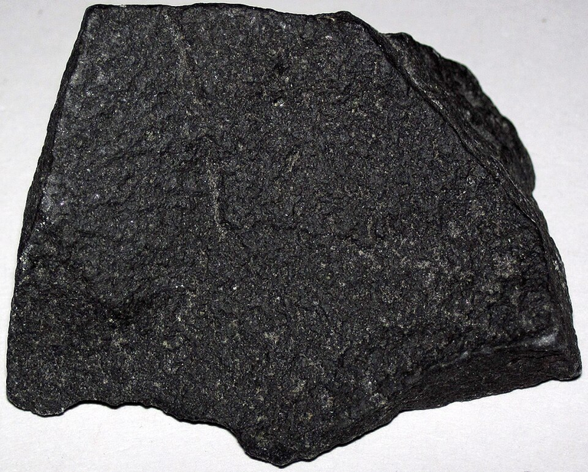
“The greatest intelligence is precisely the one that suffers most from its own limitations.”
-André Malraux
STATION 12
CLUES
1.
Igneous rock
2.
Common volcanic rock that may show bubbles
3.
Very hard, dense. Is what oceanic crust is made of
Interesting Facts:
Easter Island moai statues are carved from this material
Used in ancient grinding stones and tools
Most common rock on earth’s crust
Was one of the samples brought back from the Apollo moon missions

