Slide 1
Social Media and You
TikTok, YouTube, Facebook, X (Twitter) and Others

Slide 2
A Brief History of Social Media
In less than a generation, social media has evolved from direct electronic information exchange, to virtual gathering place, to retail platform, to vital 21st-century marketing tool.
How did it begin?
How has social media affected the lives of billions of people?
How have businesses adapted to the digital consumer lifestyle?
How do marketing professionals use social media?
It’s all part of the story of social media’s ongoing evolution.

Slide 3
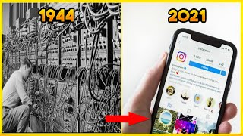
Possible Video Resource

Slide 4
Pre-internet Roots
In a sense, social media began on May 24, 1844, with a series of electronic dots and dashes tapped out by hand on a telegraph machine.
The first electronic message from Baltimore to Washington, D.C., by Samuel Morse.
Early versions of Morse Code contained versions of today’s “OMG” and “LOL.

Slide 5
Pre-internet Roots
Modern origins of today’s internet and social media point to the emergence in 1969 of the Advanced Research Projects Agency Network — the ARPANET.
created by the United States Department of Defense
allowed scientists at four interconnected universities to share software, hardware, and other data.
In 1987, the direct precursor to today’s internet came into being when the National Science Foundation launched a more robust, nationwide digital network known as the NSFNET.
A decade later, in 1997, the first true social media platform was launched.

Slide 6
Launch of Social Sites
In the 1980s and ’90s the internet’s growth enabled the introduction of online communication services such as CompuServe, America Online, and Prodigy.
They introduced users to digital communication through
email
bulletin board messaging
real-time online chatting
This gave rise to the earliest social media networks, beginning with the short-lived Six Degrees profile uploading service in 1997.

Slide 7


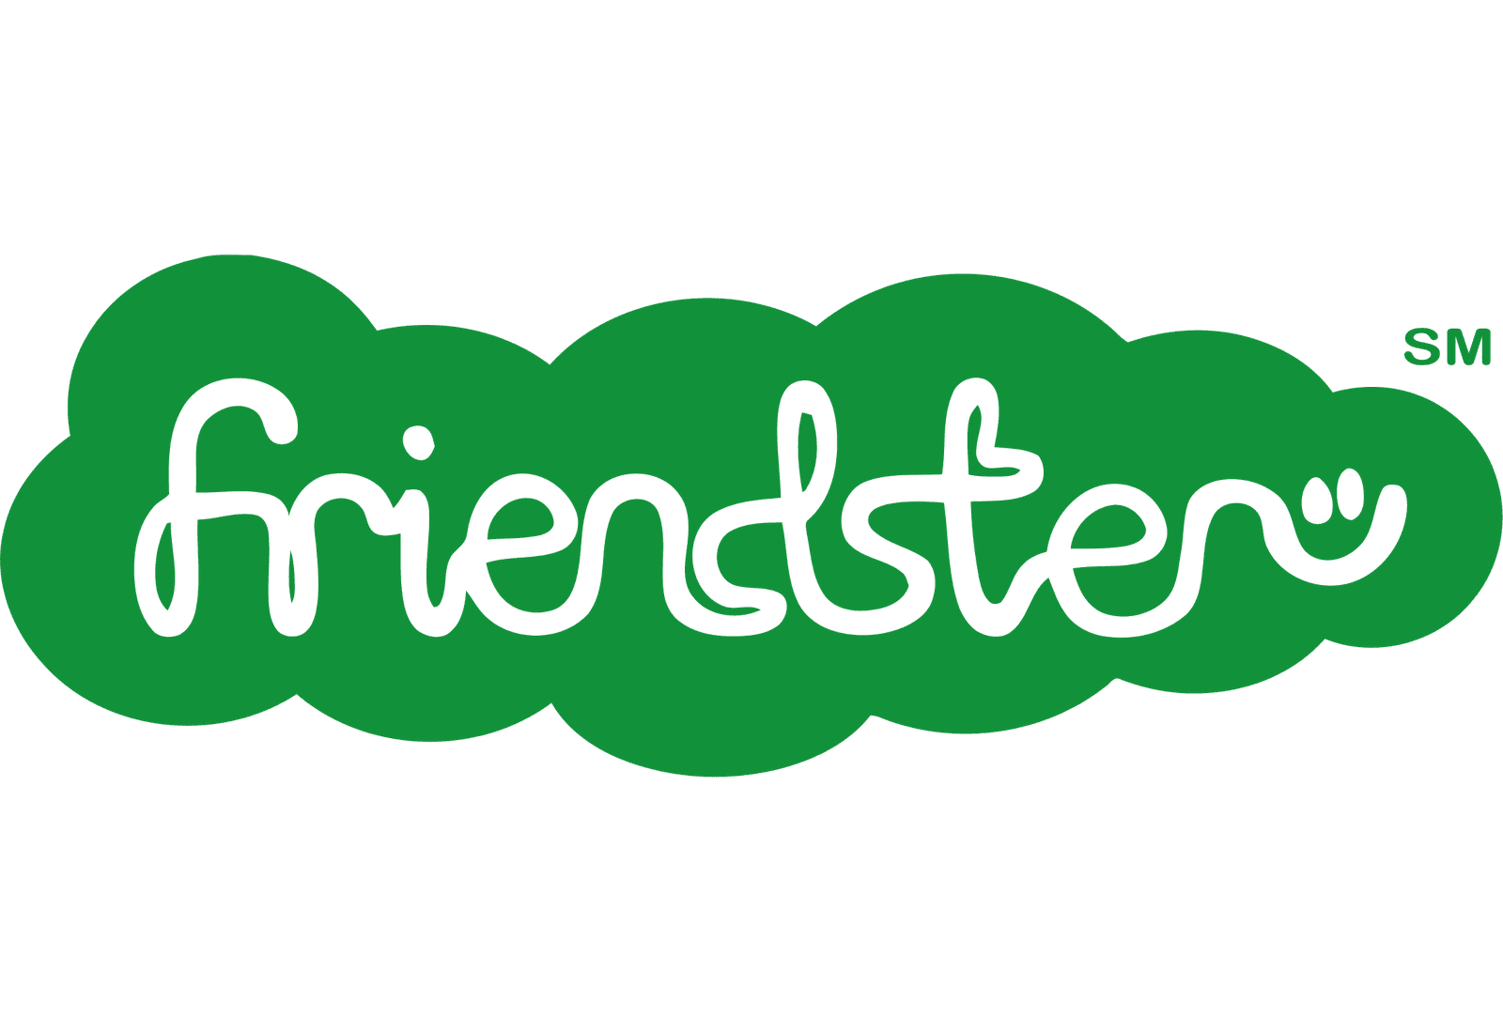

Launch of Social Sites
1997: The earliest social media networks emerged, beginning with the short-lived Six Degrees profile uploading service
2001: Friendster.
These rudimentary platforms attracted millions of users and enabled email address registration and basic online networking.
1999: Blogs began to gain popularity with the launch of the LiveJournal publishing site. This coincided with the launch of the Blogger publishing platform.

Slide 8
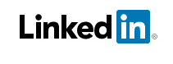
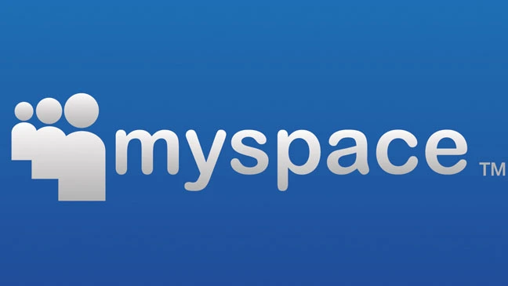
Launch of Social Sites
2002: LinkedIn was founded as a networking site for career-minded professionals.
By 2020, it had grown to more than 675 million users worldwide.
It remains the social media site of choice for job seekers as well as human resources managers searching for qualified candidates.
2003: Myspace launched
By 2006, it was the most visited website on the planet, spurred by users’ ability to share new music directly on their profile pages.

Slide 9
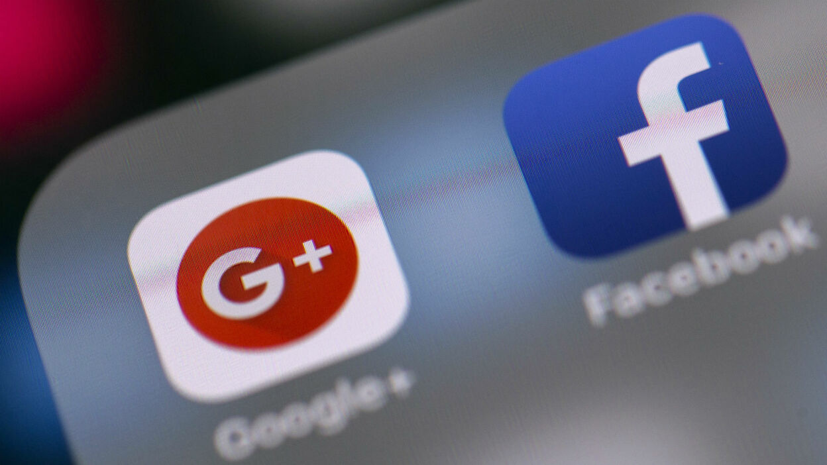
Launch of Social Sites
2008: Myspace was eclipsed by Facebook.
2011: Myspace was purchased by musician Justin Timberlake for $35 million, but it has since become a social media afterthought.
2012: Google+ launched. Their attempt to elbow its way into the social media landscape.
A rocky existence came to an end in 2018, after the private information of nearly 500,000 Google+ users was compromised by a data security breach.

Slide 10
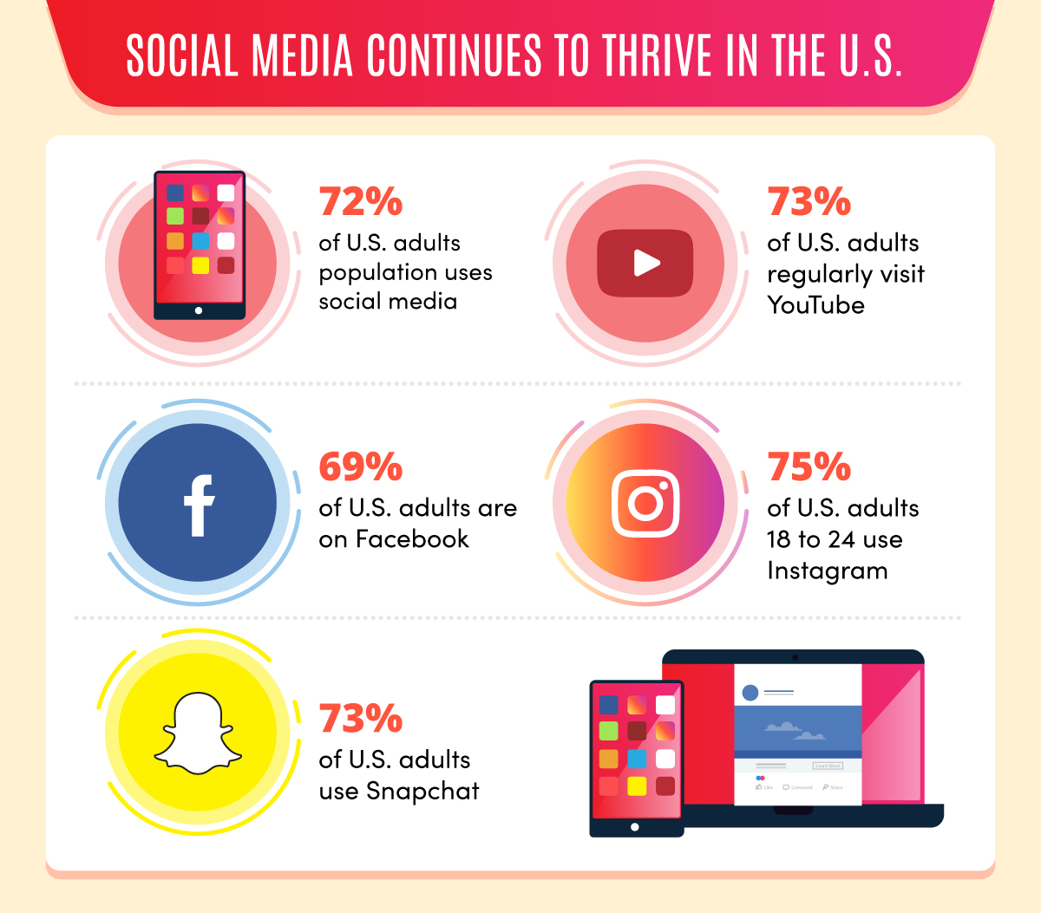

Slide 11

Modern Social Media Outlets
Today’s social media landscape is populated by a suite of services that jockey for the attention of more than 5 billion mobile device users worldwide. Here is an overview of the most prominent social media networks of modern day.
Facebook
Launched in 2004 by Harvard student Mark Zuckerberg, it has nearly 1.7 billion users — including 68% of U.S. adults
Reddit
Launched in 2005 by Massachusetts 20-somethings Steve Huffman and Alexis Ohanian as a news-sharing platform, its 300 million users have transformed Reddit into a combination news aggregation/social commentary site. Its popularity is based on the ability to “up-vote” and “down-vote” user posts.

Slide 12

Modern Social Media Outlets
YouTube
One of the largest and most popular online video distribution platforms
Founded on Valentine's Day in 2005. It was the brainchild of Chad Hurley, Steve Chen, and Jawed Karim, who were all former employees of Paypal.
It has more than 4 billion hours of video viewers monthly
An estimated 500 hours of video content are uploaded to YouTube every minute

Slide 13




Modern Social Media Outlets
X, Formerly known as Twitter
Founded in 2006 by Jack Dorsey, Evan Williams, Biz Stone, and others as a microblogging site
By 2020, 22% of U.S. adults were Twitter users.
Instagram
Founded in 2010 by Stanford graduate Kevin Systrom as a photo-sharing site
Purchased by Facebook in 2012
Has more than 1 billion users worldwide.
Pinterest
Founded in 2010 by iPhone app developer Ben Silbermann as a visual “pin board,”
has more than 335 million active monthly users.

Slide 14
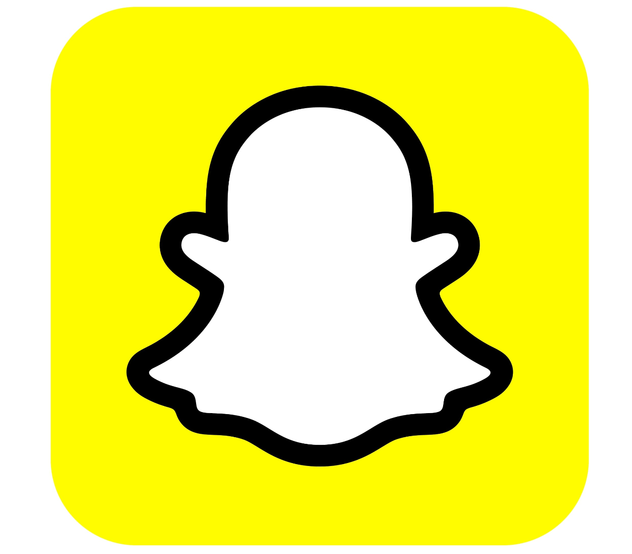

Modern Social Media Outlets
Snapchat
Founded in 2011 by a trio of Stanford students — Evan Spiegel, Reggie Brown, and Bobby Murphy
This video-sharing service introduced the concept of “stories,” or serialized short videos, and “filters,” run for informative digital effects, often based on location.
TikTok
Founded in 2016 by Chinese tech company ByteDance
this short-form video-sharing site was merged with the U.S.-based mobile app Musical.ly in 2018
became popular with American teens and young adults
As of early 2020, it had more than 800 million users worldwide.

Slide 15
Reflect & Answer
Which social media platforms do you currently use?
Which A.I. language model are you using? ( Chat GPT, Gemini,)
How often do you use them both? (social media and A.I.)
Are there any social media platforms that you have used in the past that you no longer use?
Why did you stop using these platforms?

Slide 16
Compare and Contrast
What types of media do you expect to see on these different platforms?
TikTok
Social Media (specify which platforms)
YouTube
Television

Slide 17
Reflect & Answer
Why do you think some forms of media and A.I. work better on certain platforms than others?
How do you see the future of social media,television and A.I. evolving in the next year? 5 years? 10 years? 50 years?
How do you see yourself interacting with these future changes?

Slide 18
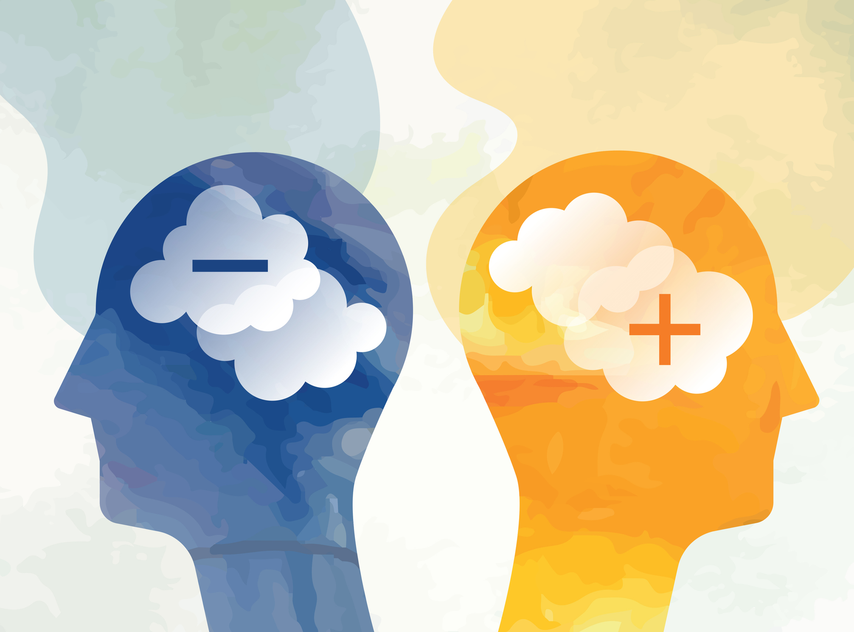
Positive and Negative Effects
Brainstorm 4 positive effects that social media, television and A.I. have.
Brainstorm 4 negative effects that social media, television and A.I. have.

Slide 19
Positive Effects of Social Media and A.I.
Communicate and stay up to date with family and friends around the world.
Find new friends and communities; network with other people who share similar interests or ambitions.
Join or promote worthwhile causes; raise awareness on important issues.
Seek or offer emotional support during tough times.
Find vital social connection if you live in a remote area, for example, or have limited independence, social anxiety, or are part of a marginalized group.
Find an outlet for your creativity and self-expression.
Discover (with care) sources of valuable information and learning.

Slide 20

Negative Effects of Social Media and A.I.
Inadequacy about your life or appearance
Even if you know that images you’re viewing on social media are manipulated, they can still make you feel insecure about how you look or what’s going on in your own life.
We’re all aware that other people tend to share just the highlights of their lives, rarely the low points that everyone experiences.
But that doesn’t lessen those feelings of envy and dissatisfaction when you’re scrolling through a friend’s airbrushed photos of their tropical beach holiday or reading about their exciting new promotion at work.

Slide 21
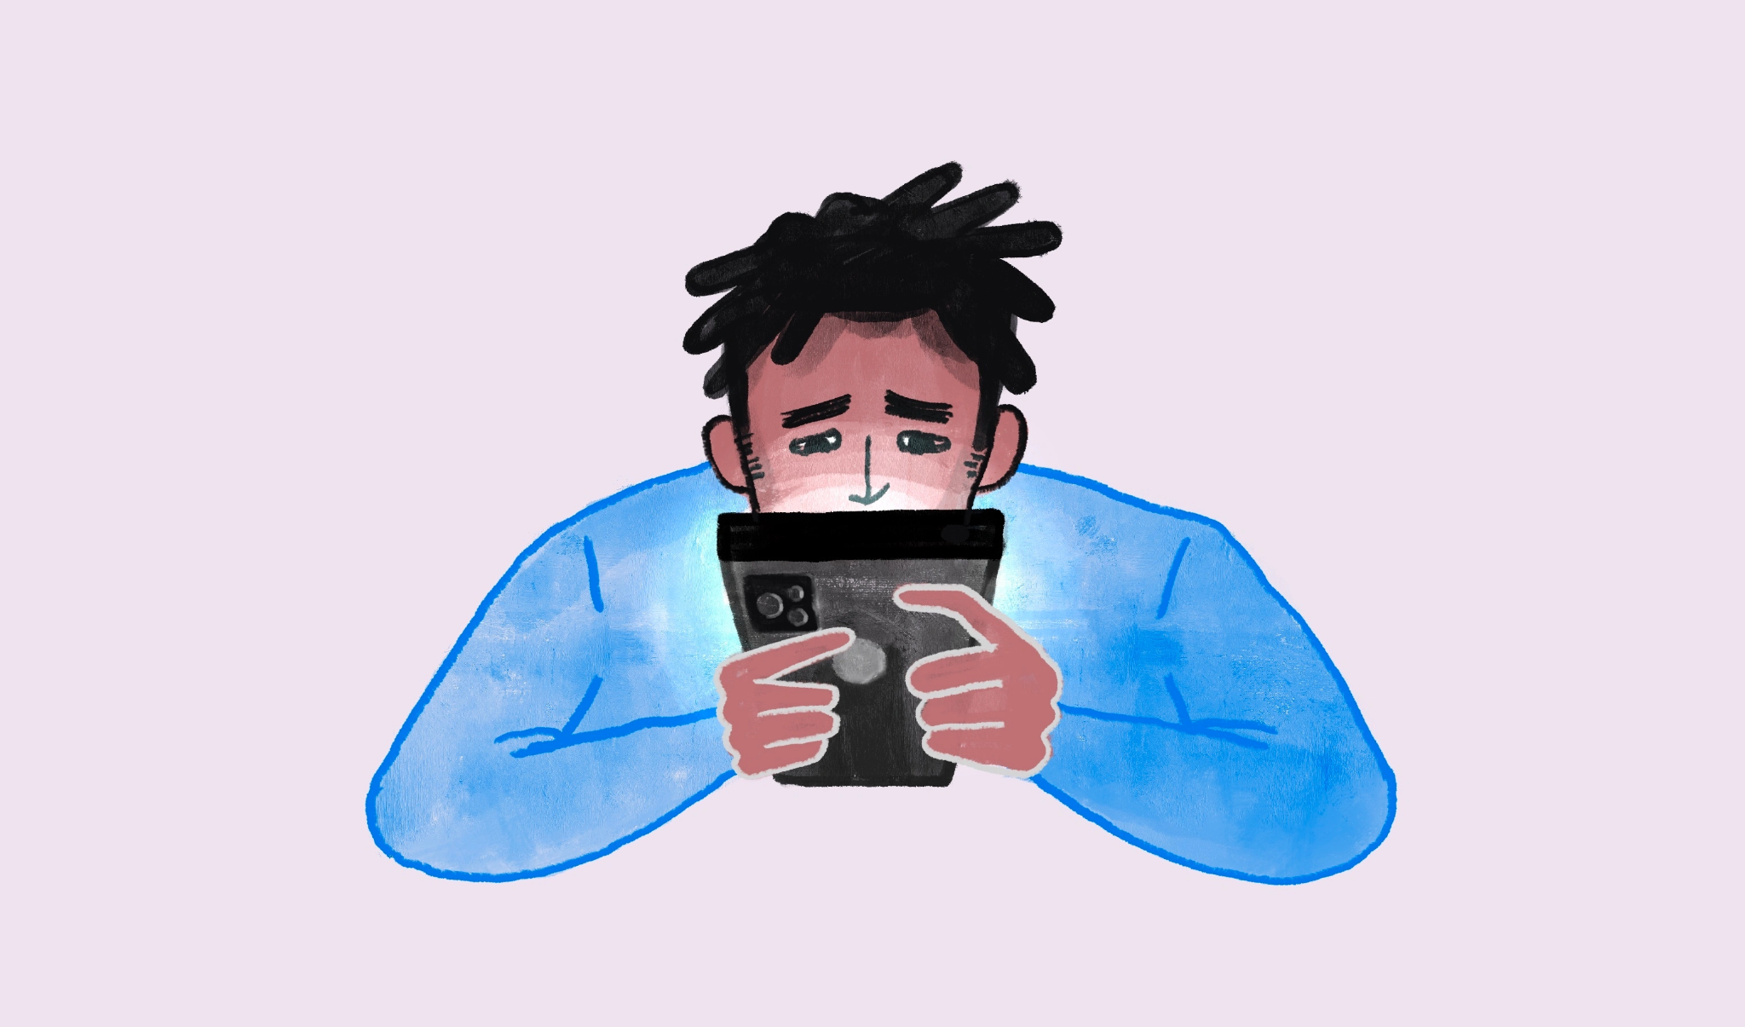
Negative Effects of Social Media and A.I.
Fear of missing out (FOMO) and social media addiction
While FOMO has been around far longer than social media, sites such as Facebook and Instagram seem to exacerbate feelings that others are having more fun or living better lives than you are.
The idea that you’re missing out on certain things can impact your self-esteem, trigger anxiety, and fuel even greater social media use, much like an addiction.
FOMO can compel you to pick up your phone every few minutes to check for updates, or compulsively respond to each and every alert—even if that means taking risks while you’re driving, missing out on sleep at night, or prioritizing social media interaction over real world relationships.

Slide 22

Negative Effects of Social Media and A.I.
Isolation
A study at the University of Pennsylvania found that high usage of Facebook, Snapchat, and Instagram increases rather decreases feelings of loneliness.
Conversely, the study found that reducing social media usage can actually make you feel less lonely and isolated and improve your overall wellbeing.
Depression and anxiety
Human beings need face-to-face contact to be mentally healthy.
Nothing reduces stress and boosts your mood faster or more effectively than eye-to-eye contact with someone who cares about you.
The more you prioritize social media interaction over in-person relationships, the more you’re at risk for developing or exacerbating mood disorders such as anxiety and depression.

Slide 23
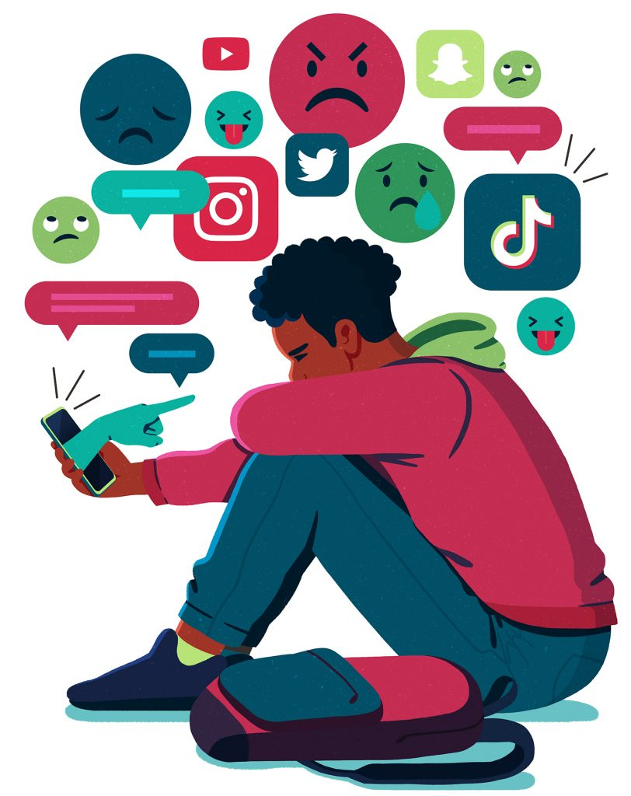
Negative Effects of Social Media and A.I.
Cyberbullying
About 10 percent of teens report being bullied on social media and many other users are subjected to offensive comments.
Social media platforms such as Twitter can be hotspots for spreading hurtful rumors, lies, and abuse that can leave lasting emotional scars.
Self-absorption
Sharing endless selfies and all your innermost thoughts on social media can create an unhealthy self-centeredness and distance you from real-life connections.

Slide 24
Time for a Change?
Do you see yourself potentially changing how you use Social Media based on the positive and/or negative effects addressed?
Complete the Social Media, You and A.I. worksheet assignment.

